Slide 1
Table and Forms Access Business Problem 2 IDS 200 – Spring 2017

Slide 2
Objectives
Add a new field in an existing table and use Zoom;
Create a form using different form tools;
Add a form title, header & footer;
Form’s controls;
Add a logo to a form;
Add a “Close” command button to a form.
2

Slide 3
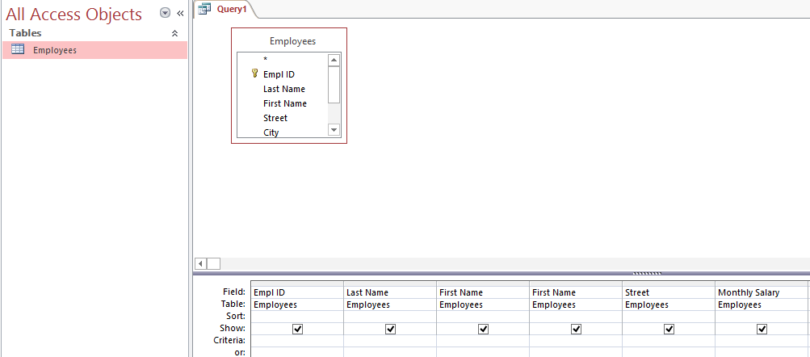
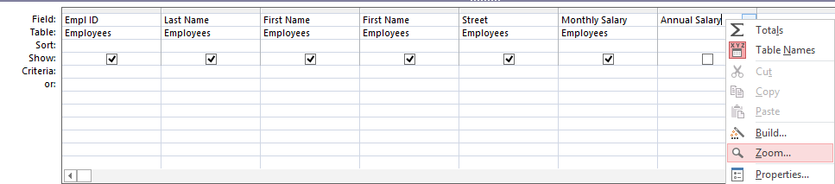
1. Add a New Field in an Existing Table and Use Zoom
In this example, we want to calculate the annual salary of each employee using formula Annual Salary = Monthly Salary * 12
Step 1: Go to CREATE tab and select Query Design in the Queries group
Step 2: Add the table you are going to work on from the pop up window; in this example, it’s the Employees table.
Step 3: Double click on the fields which are relevant to the query so that the fields appear in the query window. In this case the fields are EmployeeID, Last Name, First Name, Street and Monthly Salary.
Step 4: In the query window, create a new field called “Annual Salary” in the blank field. (Without pressing Enter, proceed to step 5.)
Step 5: To define the formula for the new field, right click on the field and choose the “Zoom” option from the Menu.

Slide 4
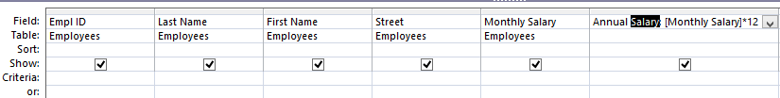
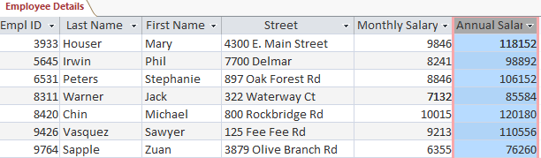
Add a New Field in an Existing Table and Use Zoom - continued
Step 6: In the Zoom window, type the related formula. Note: the fields which are taken from the table are enclosed by the [ ]. Furthermore, use “:” instead of “=“ sign. Use Annual Salary: [Monthly Salary] * 12
Step 7: Click OK.
Step 8: Save the query as Employee Details.
Step 9: Run the query and open it to see the annual salary of each employee.
4

Slide 5
2. Create a Form
A form is a database object that displays data from one or more tables or queries in a format similar in appearance to a paper form.
The tables or queries that provide the data for display in a form are the record source.
Most database experts agree that users should make all database updates using a form.

Slide 6
Create a Form - continued
Access includes tools that can be used to create different kinds of forms. The different options for creating forms are located in the Forms group on the Create tab.
The Form tool creates a simple form that includes all the fields in the selected table or query, uses a simple format, and includes a title with the same name as the table or query on which it is based.
When fields appear in a form, they appear in controls.
When a tool is used to create a form, it opens in Layout view.

Slide 7
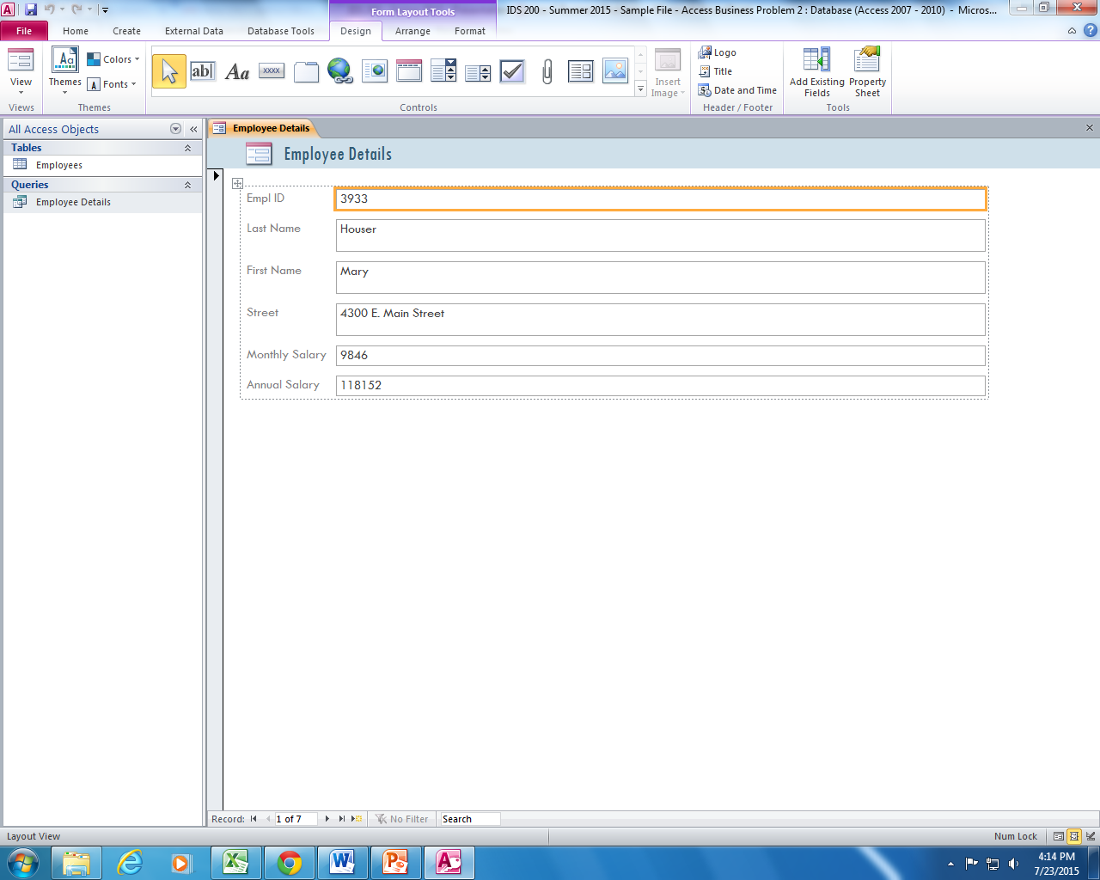
Create a Form – Form Tool
An example of a form created by the Form tool:
Form title
Label control
Text box control
Record navigation bar
Layout view

Slide 8
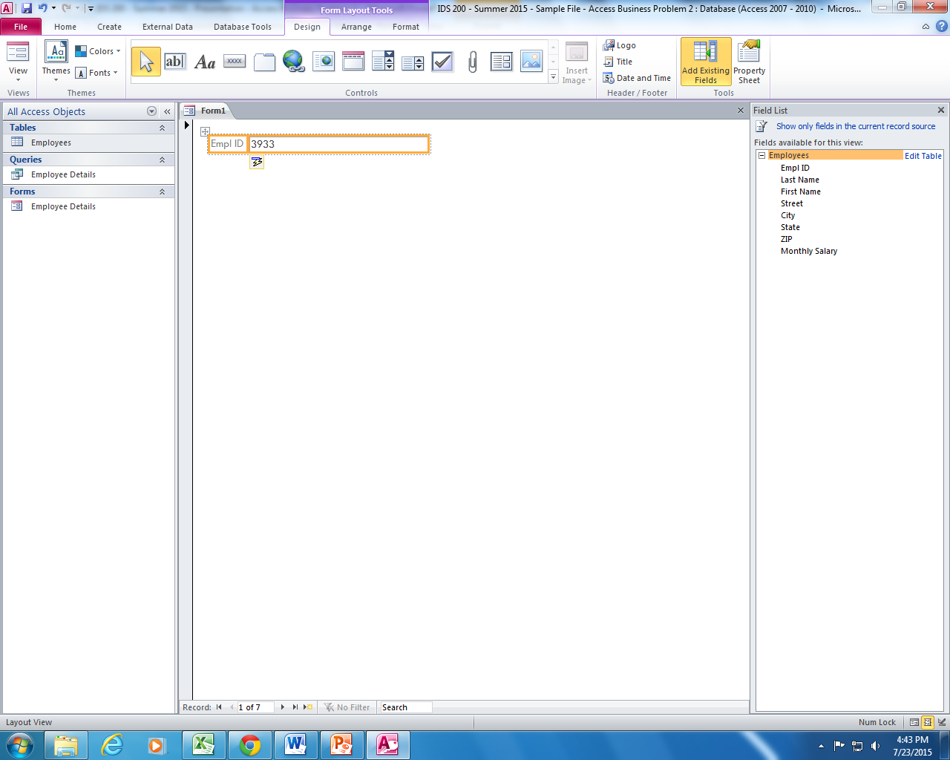
Create a Form – from Scratch
To create a new form from scratch, click the Create tab on the Ribbon, and then click the Blank Form button in the Forms group.
The Field List pane will appear and it contains the tables in the database that can be used to create the form. To add field(s) to the form, double-click the field(s) in the Field List pane.
As fields are added to a form in the Layout view, Access adds them to a control layout.
A control layout is a "container" that groups together the controls in a form so that users can change them as a group.
Add all field from the Employees table to the form.

Slide 9
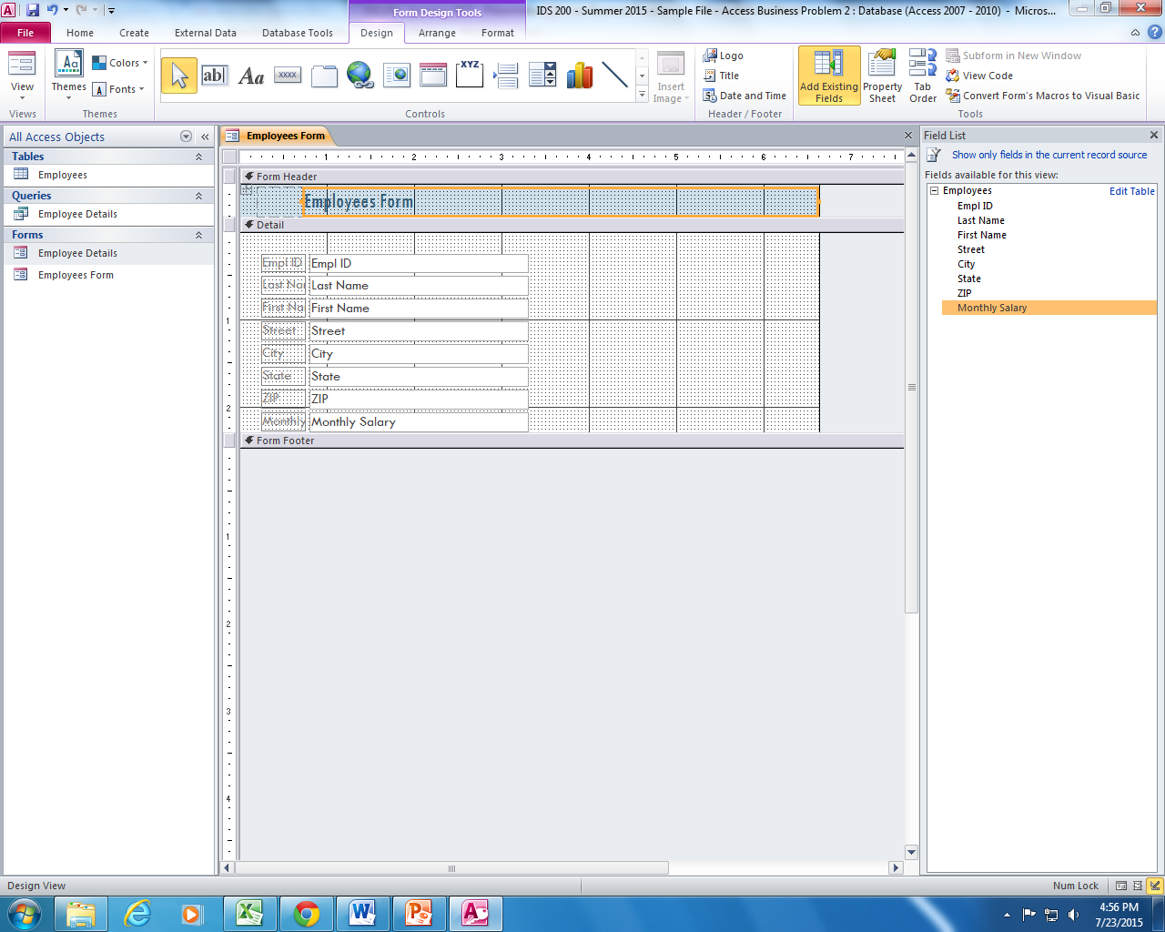
3. Add the Form Title and Show the Form Header & Footer
To add the title, in the Design menu, under the Header / Footer group, click Title. Change the form title to Employees Form. Save and name it according to the title.
Click the Design view to show the areas of form header and footer.
The size and position of the form objects can be adjusted.
Click on the property sheet to help with the design and formatting of a particular object selected in the form.

Slide 10
4. Form’s Controls
Two types of controls can be added to a form:
A bound control which is connected to a field in the record source and is used to display, enter, and update data.
An unbound control which is not connected to a record source and is used to display information, lines, rectangles, and pictures.

Slide 11
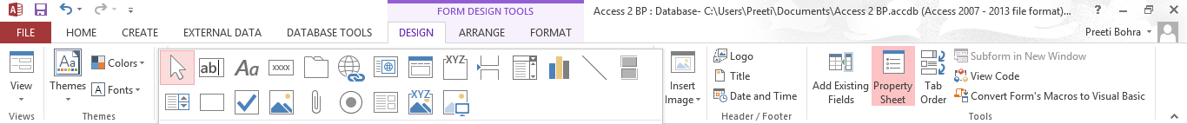
Form’s Controls - Examples
00
Controls can be used to display, enter, filter, or organize data in Access.
Text boxes
Used to display data e.g. from a record source.
Can be bound/unbound.
Labels
Used to display descriptive text such as titles, captions, or brief instructions.
Labels don’t display values from fields or expressions.
Unbound.
List boxes, combo boxes and drop-down list boxes
Used when it's quicker and easier to select a value from a list than to remember a value to type.
Can be bound/unbound.
Command buttons
Provide a way of performing action(s) by simply clicking them.
Unbound.
Check boxes
Used to display a Yes/No, True/False, or On/Off value from an underlying table, query.
Can be bound/unbound.
Option groups
Used to display a limited set of alternatives.
Can be bound/unbound.
Scrolling text control
Used to display moving text or text that scrolls.
Unbound.
18

Slide 12
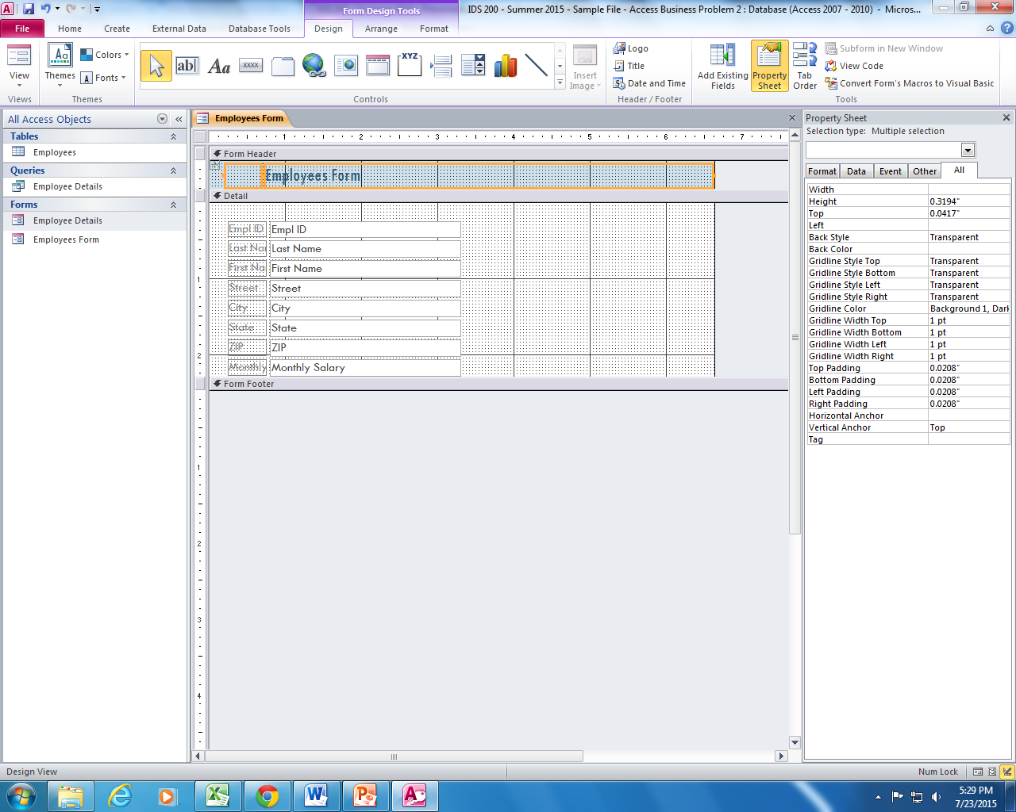
5. Add a Logo to a
Select the Design View.
Go to the position where the logo needs to be placed, e.g. the header or footer section.
Click the Logo button and insert the logo.
Resize the logo as desired by dragging it’s edges.
17

Slide 13
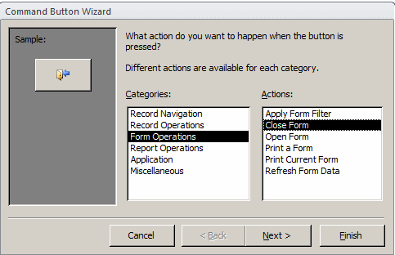

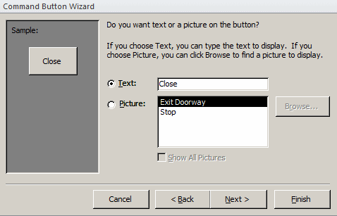
6. Create and Add a “Close” Command Button
Select the Design View.
In the Controls section of the Ribbon, click the More button and click the Use Control Wizards to set it on
Click the Button and click at the desired area where the button is to be placed.
On the first page of the Command Button Wizard, in the Categories list, click Form Operations and then select the Close form action. Click Next.
Replace the content of the Text edit box with Close. Click Next.
Change the name of the button to ”cmdClose”. Click Finish.
Switch the form to Form View.
A click on the Close button will close the form.

